Slide 1
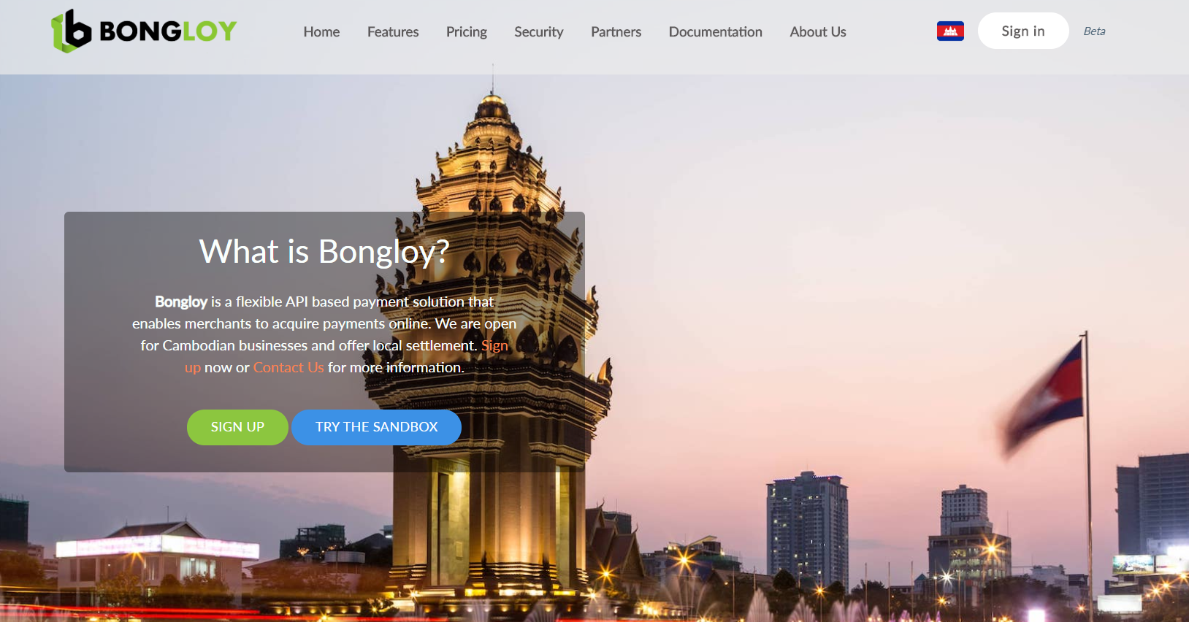
Bongloy Is A FinTech Company That Specialises In Digital Payments

Slide 2
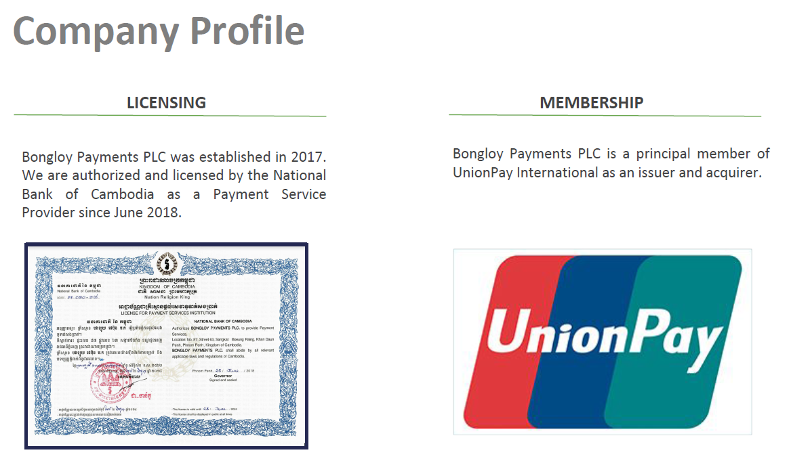

Slide 3
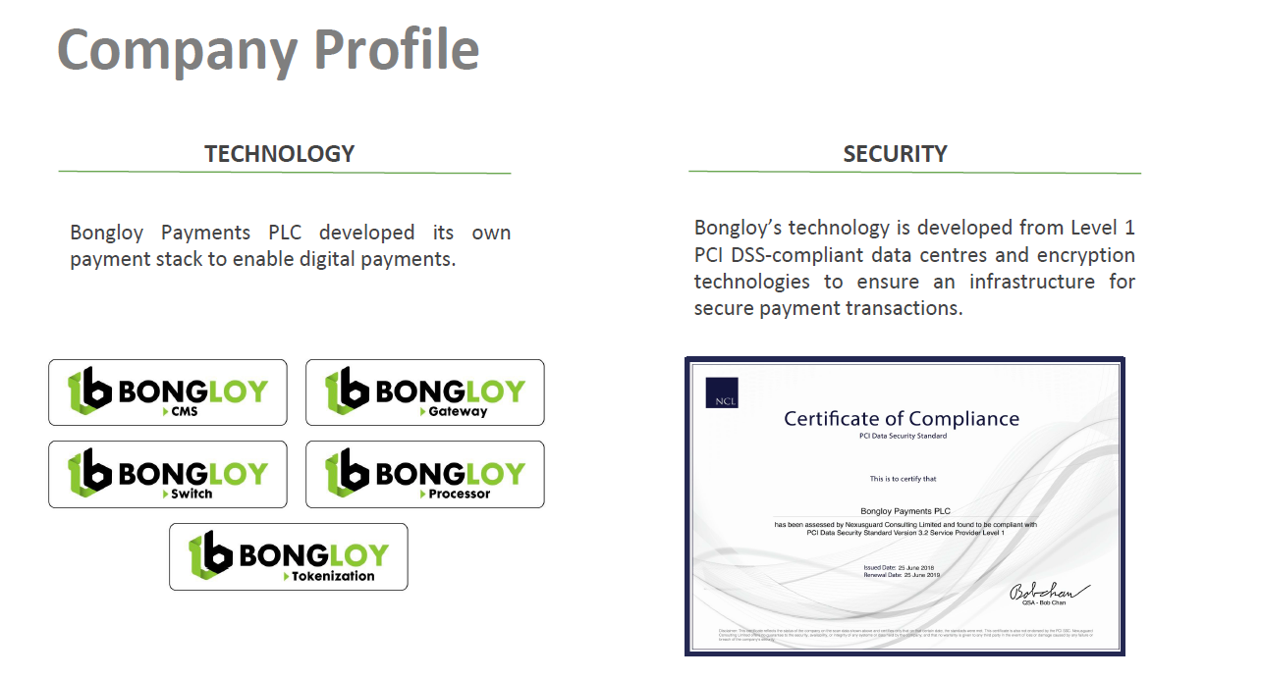

Slide 4
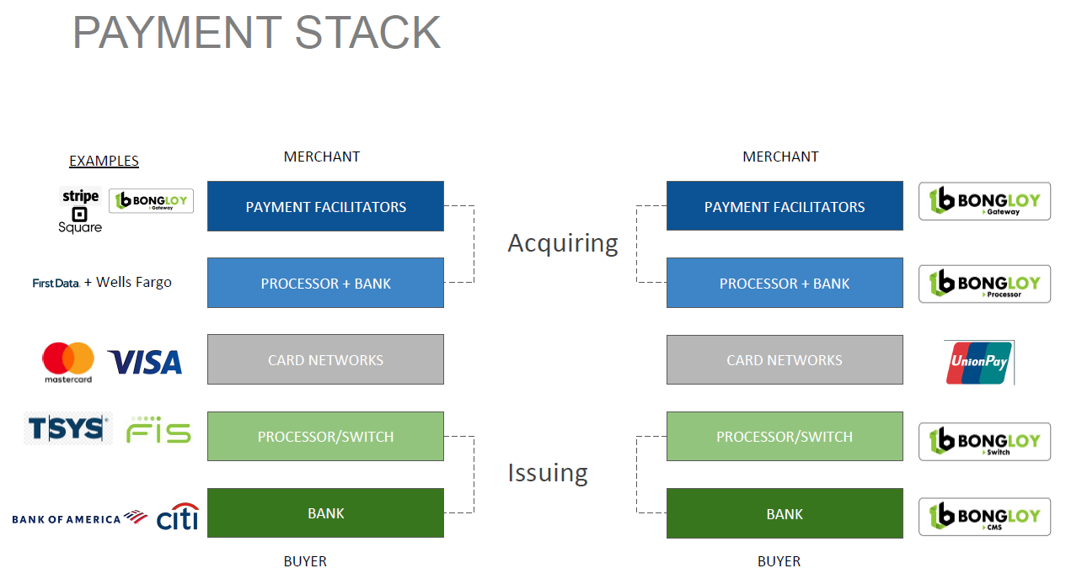

Slide 5
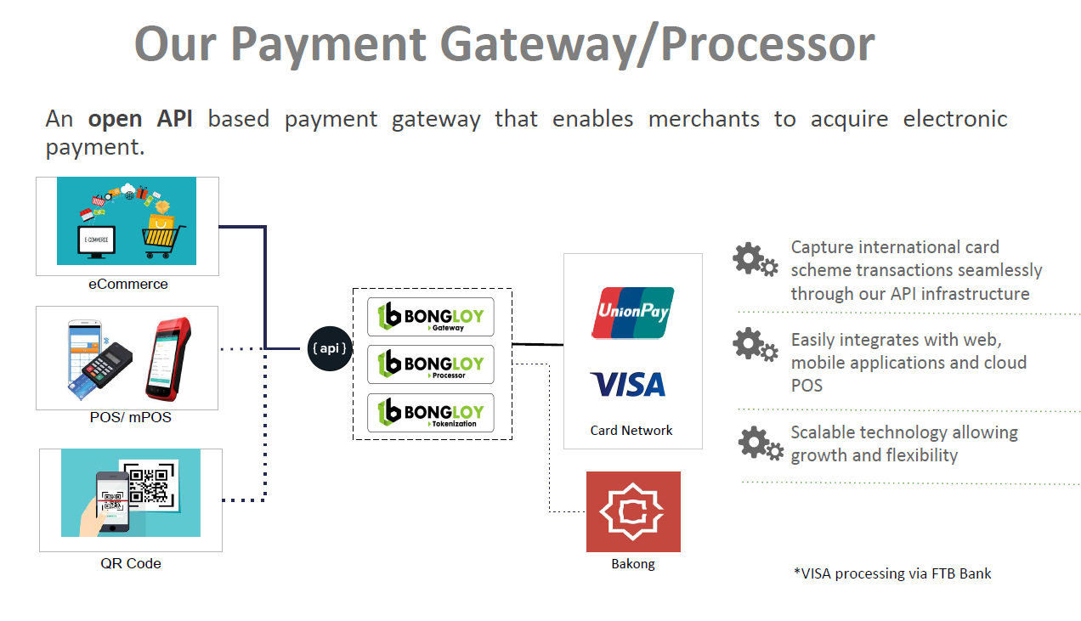

Slide 6
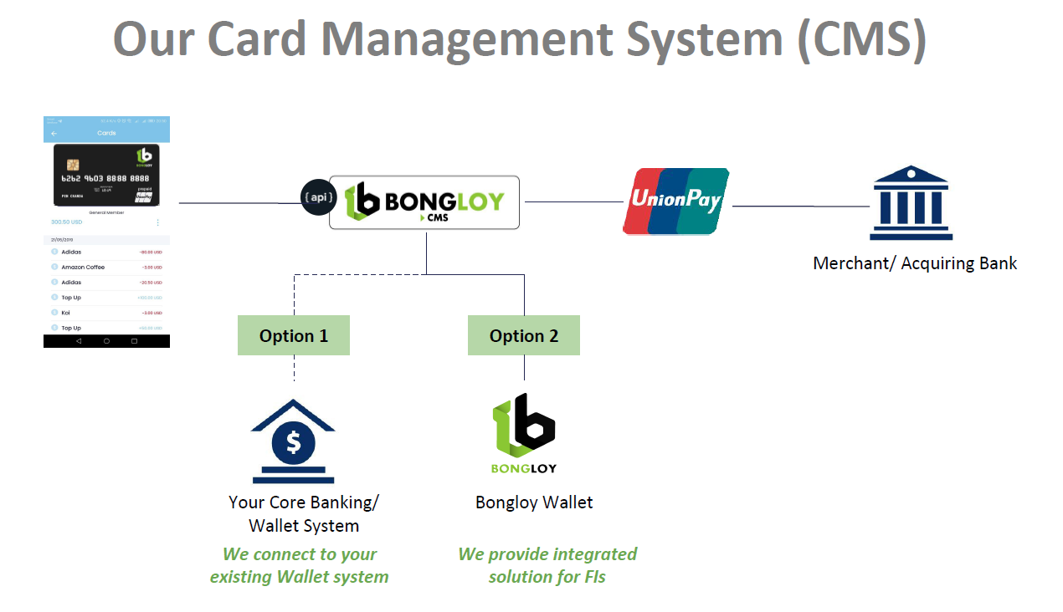

Slide 7
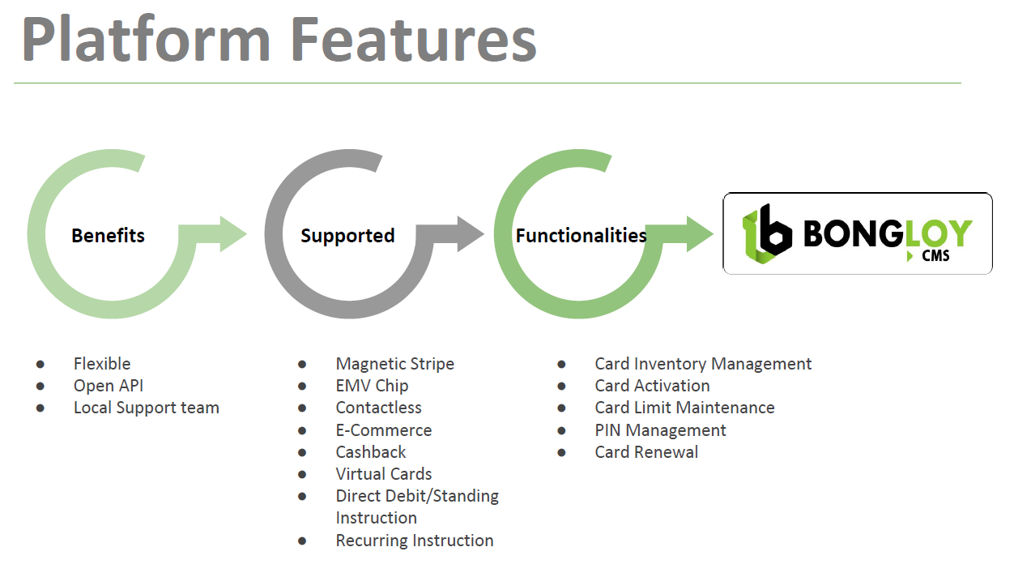

Slide 11
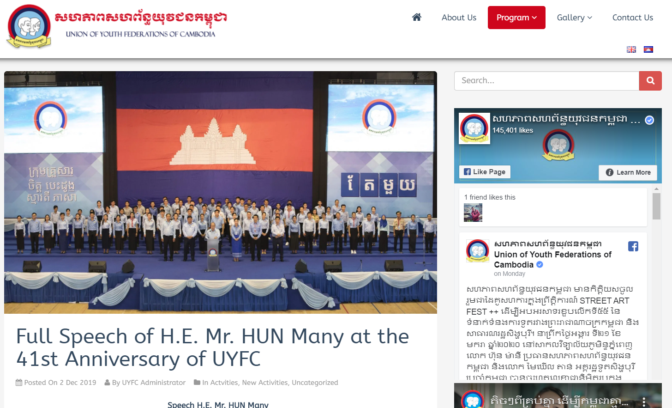
Bongloy Engaged HBI To Issue A UPI Prepaid Member Card To UYFC Party

Slide 12
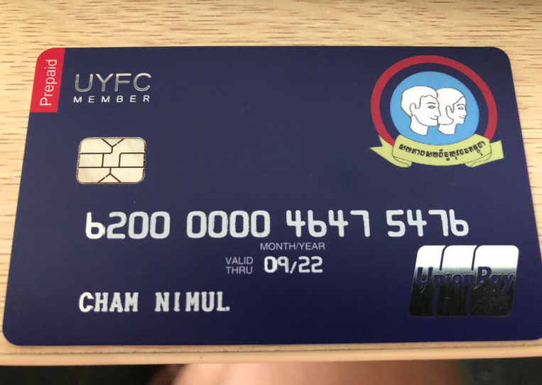
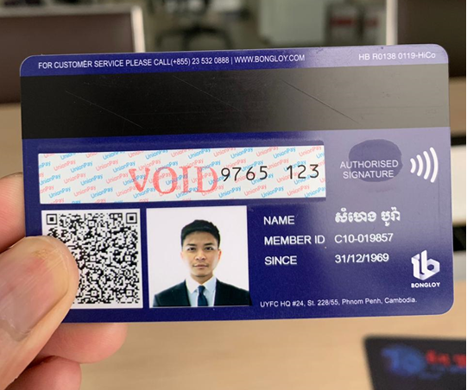
UYFC Card Personalisation Requirements:
Front-Side
Thermal White for PAN, Name
Back-Side:
Color Photo
QR Code
Cardholder name (Khmer)

Slide 13
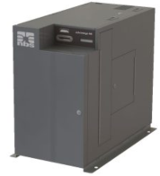


Project Requirements:
To print a) white with Khmer font wording for cardholder name
b) coloured picture on back-side of card
Problem: Thermal printers only have single thermal head for either monochrome
(black or white) printing or coloured (CMYK) printing.
Solution: Make use of 2 thermal printers, and provide read-back settings such that there is no possibility of misprint of different cardholder data on same card
2-Pass Card Personalization
Magnetic-stripe data
Picture data
(colored printing)
Cardholder data
(white printing)
Capture cardholder information

Slide 14
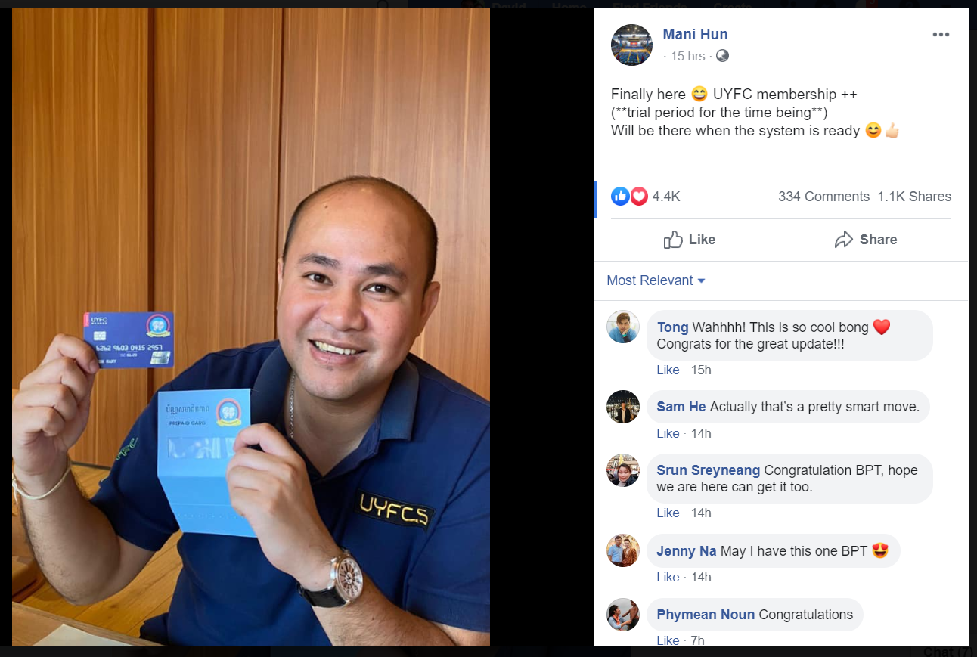
Mr. Mani Hun (President of UYFC) Facebook Post on 23rd Jan 2020

Slide 15
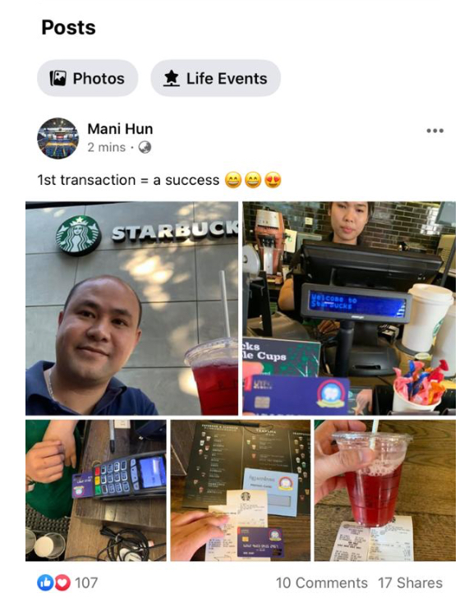
Mr. Mani Hun (President of UYFC) Facebook Post on 23rd Jan 2020

Slide 16
THANK YOU

Slide 17

Criteria for Business Into Cambodia Markets
Does new businesses help in promoting company core business – cards?
Do HBI have expertise in this area?
Does HBI have good partners to leverage upon?
Can new business bring in new opportunities for business in other fields i.e. managed services?

